Slide 1
CHEMISTRY

Slide 2
The field of study that deals with matter, its composition, characteristics and the reactions that they undergo

Slide 3
MYP 4 UNIT 1 CHEMISTRY MATTER (What is matter & How do we use matter)
9TH GRADE

Slide 4
UNIT OVERVIEW
KEY CONCEPT:
Change
RELATED CONCEPT/S:
Models
GLOBAL CONTEXT:
Identities and Relationships
EXPLORATION:
human nature and human dignity, moral reasoning and ethical judgment

Slide 5
STATEMENT OF INQUIRY:
When matter changes, we observe similarities and differences that help us build models to explain underlying relationships
ATL SKILLS:
Thinking skills:
Critical thinking - Draw reasonable conclusions and generalizations.
Transfer - Apply skills and knowledge in unfamiliar situations.

Slide 6
LESSON 1
MATTER

Slide 7
OBJECTIVES
● Discuss the different states of matter and their characteristics
● Explain the processes of state changes

Slide 8
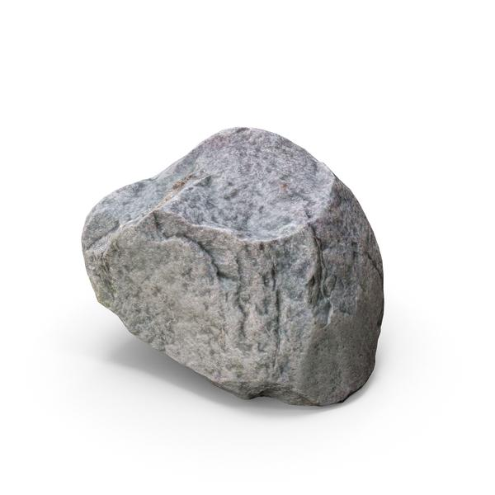
Unscramble these words
1. onatpravioe
2. zeringef
3. geltinm
4. esiiontpod
5. oenndsaioncc
6. aonlusibimt

Slide 9
Using the Frayer’s model
Definition
Characteristics
Matter
Examples
Non-examples

Slide 10
Students in groups:
State the three states of matter
State 3 examples of each state

Slide 11
Students in groups:
State the three states of matter
State 3 examples of each state

Slide 12
Connect each of the states of matter using arrow to show the changes that occurs between each state

Slide 13
States of Matter
Solid
Liquid
Gas
Plasma

Slide 14
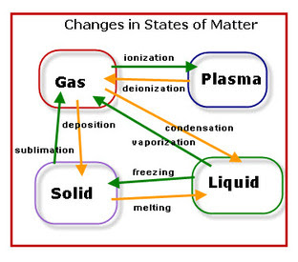

Slide 15
LESSON 2
Testing Matter

Slide 16
OBJECTIVE
By the end of the lesson, the student will be able to:
outline the basic steps involved in designing experiments.

Slide 17
Which laboratory apparatus is used to measure the volume of a liquid?

Slide 18
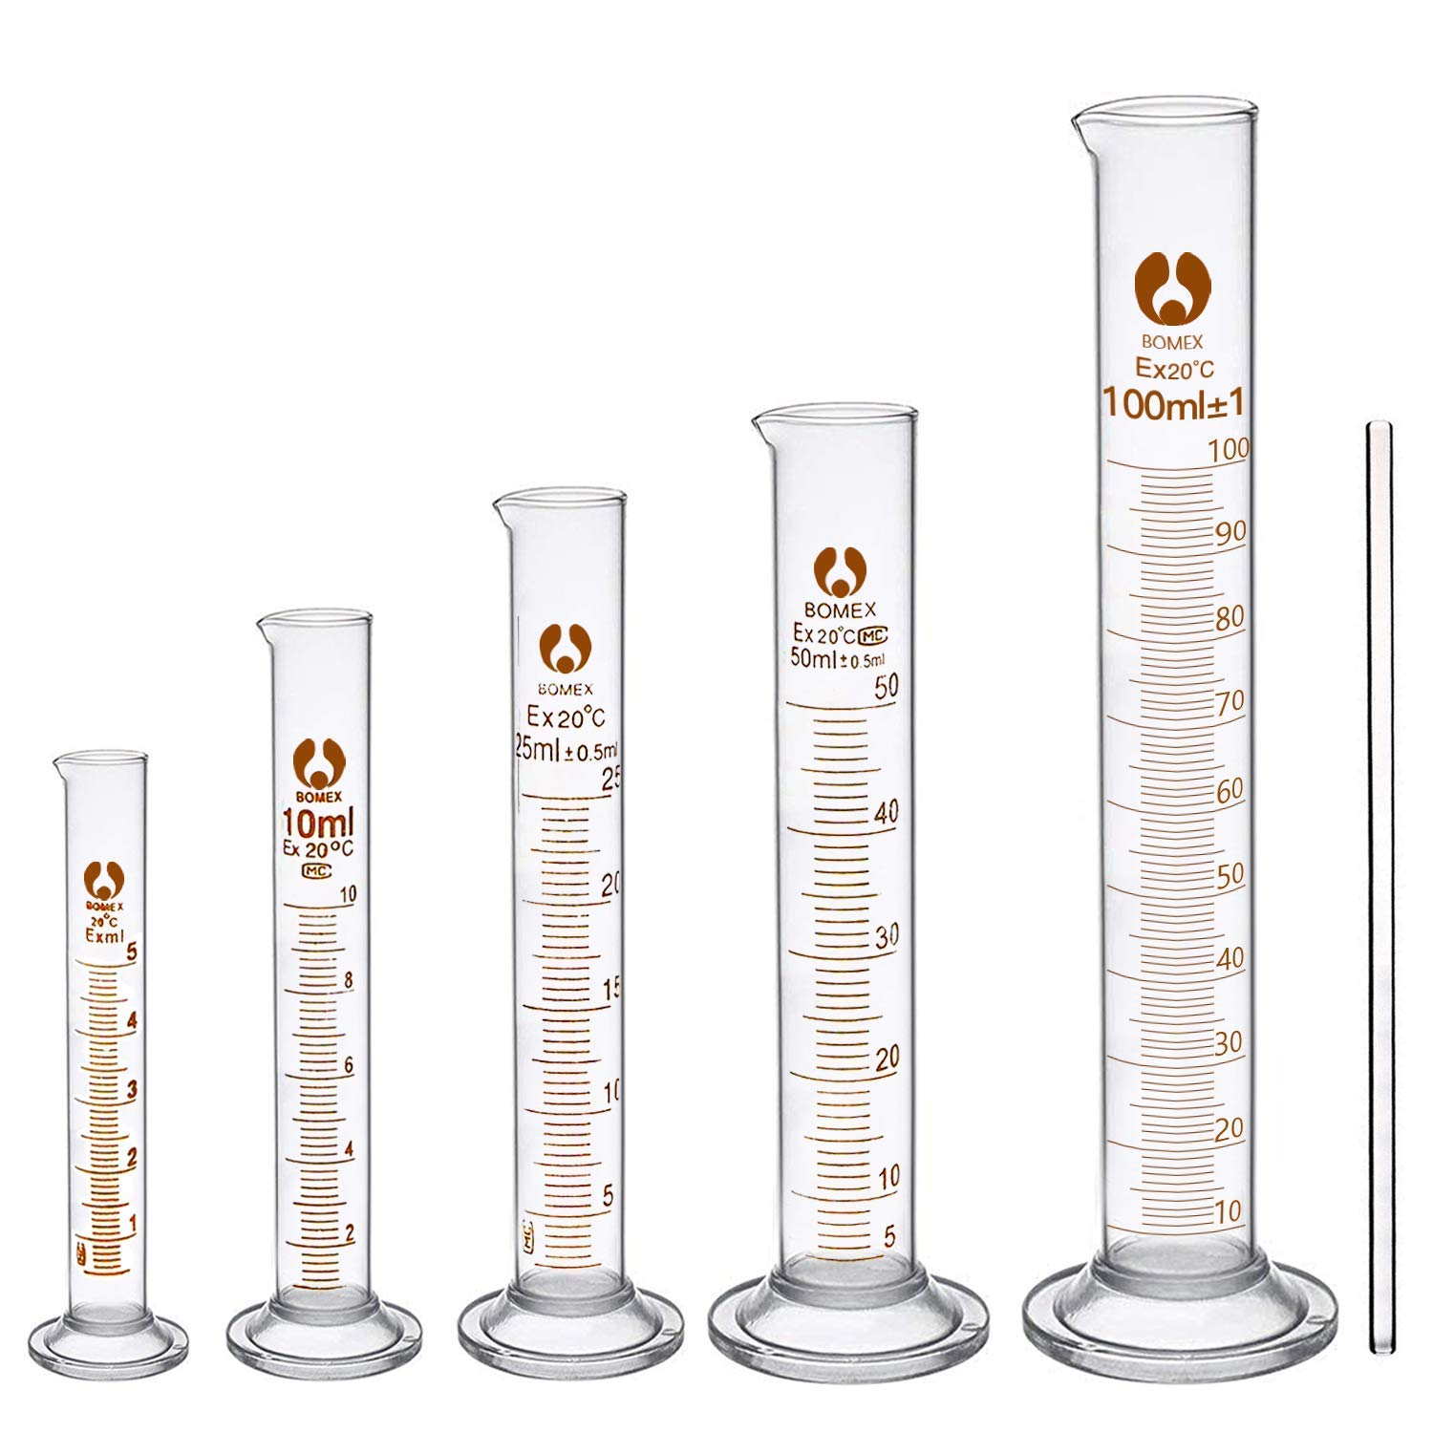
Measuring Cylinder

Slide 19
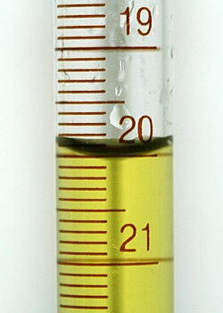
The volume is measured by observing the curve of the meniscus at eye level.
A meniscus is the curve seen at the top surface of a liquid in a container

Slide 20
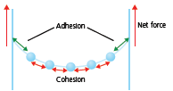
A meniscus is caused by two sets of forces:
Cohesion: which is the attraction of water to itself
Adhesion: the attraction of water to
the sides of the container.

Slide 21
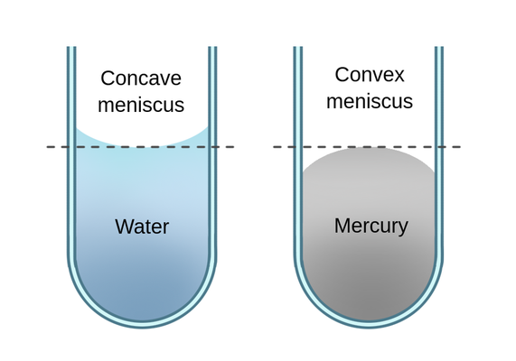
Concave meniscus
A concave meniscus occurs when the liquid molecules are more attracted to the container than to each other, like water in glass
Convex meniscus
A convex meniscus occurs when liquid molecules are more attracted to each other, like mercury in glass

Slide 22
DESIGNING EXPERIMENTS IN CHEMISTRY
Aim
Apparatus/Materials
Method/Procedure
Analysis/Results/Observation
Conclusion

Slide 23
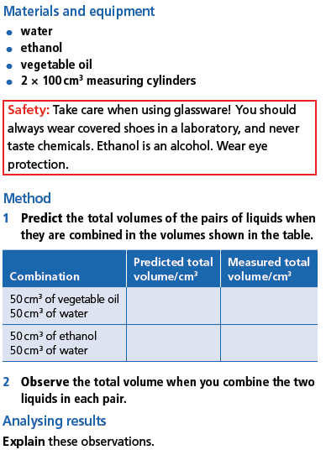
How does Matter mix?

Slide 24
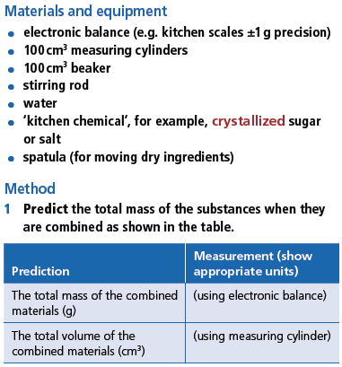
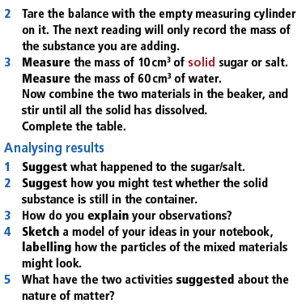
How does Matter add up?

Slide 25
LESSON 3
DENSITY

Slide 26
OBJECTIVE
By the end of the lesson, the student will be able to:
explain the relationship between mass, volume, and density.

Slide 27
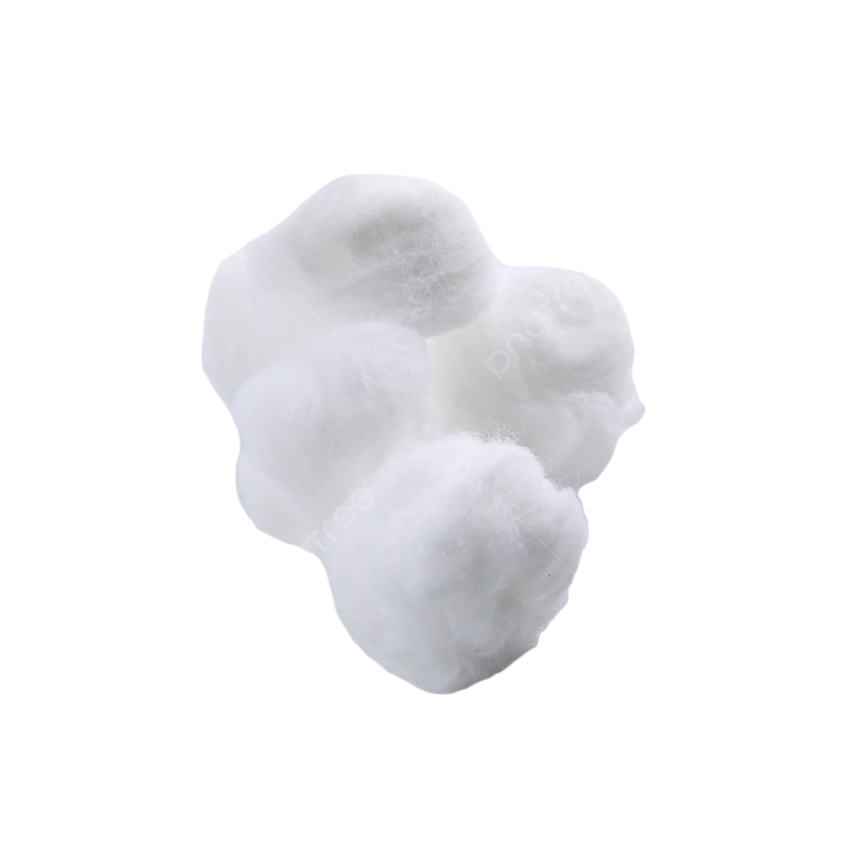
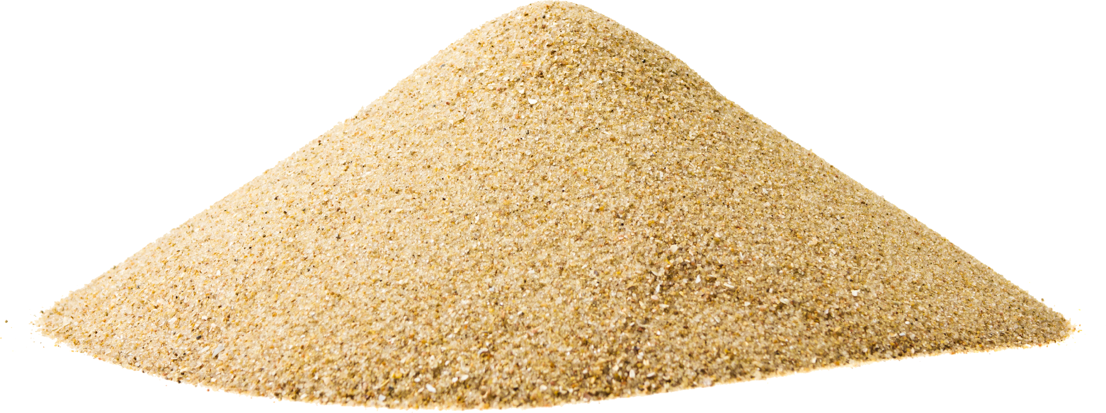
Which of these is the heaviest and which is the lightest?
A pound of cotton, a pound of stone and a pound of sand
Arrange them in order of increasing mass

Slide 28
An Experiment to determine the density of Irregular objects

Slide 29
DENSITY
Density can be defined as the mass per unit volume of a substance

Slide 30
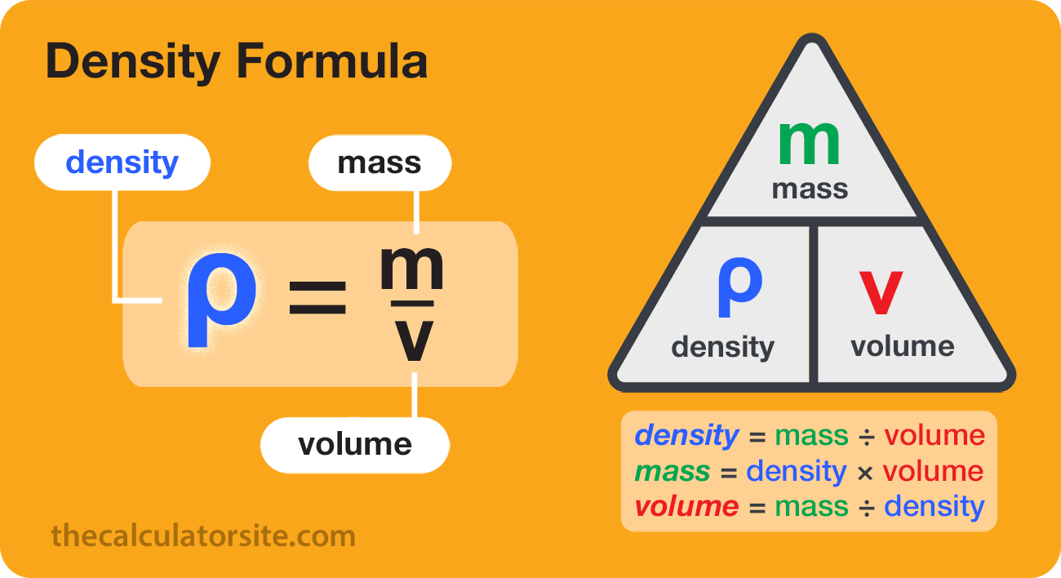

Slide 31
Mass (m)
Unit: kg or g
Volume (v)
Unit: m³ or cm³
Density
Unit: kg/m³ or g/cm³

Slide 32
Example 1
An object has a mass of 25 g and a volume of 10 cm³. Calculate its density and determine whether it will be more dense or less dense than water

Slide 33
Example 2
A bottle of water has a density of 1000 g/cm³ and a mass of 0.5 g. Calculate the volume of water bottle giving your answer in Liters

Slide 34
An Experiment to determine the density of regular and irregular objects

Slide 35
DENSITY REGULAR OBJECTS
Aim: To determine the density of a regular block
Materials: Block, Electronic balance, rule

Slide 36
Procedure:
1. Measure the mass of the block and record as m
2. Measure the length and record as L
3. Measure the breadth and record as B
4. Measure the height and record as H

Slide 37
Results:
Mass =
Length =
Breadth =
Height =
Volume = L × B × H
Density = mass/volume

Slide 38
A regular block of mass 20 kg has length 10m, a width of 5m and a height of 7m. Determine the density of the block

Slide 39
DENSITY IRREGULAR OBJECTS
Aim: To determine the density of an irregular block
Materials: rock, Electronic balance, measuring cylinder, rope, water

Slide 40
Procedure:
1. Measure the mass of the block and record as m
2. Pour a desired amount of water into the measuring cylinder and record your volume V₁
3. Tie the rock with the rope and dip it gently in the measuring cylinder containing the water and record the volume V₂
4. Determine the Volume (V₂ – V₁)

Slide 41
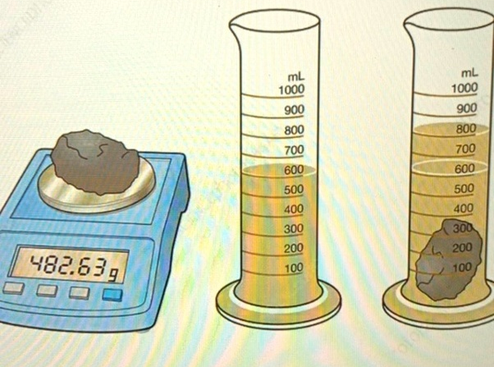

Slide 42
Results:
Mass =
Volume, V₁=
Volume, V₂=
Density = mass/volume

Slide 43
DENSITY IRREGULAR OBJECTS
Aim: To determine the density of an irregular block
Materials: rock, Electronic balance, measuring cylinder, rope, water

Slide 44
Procedure:
1. Measure the mass of the block and record as m
2. Pour a desired amount of water into the measuring cylinder and record your volume V₁
3. Tie the rock with the rope and dip it gently in the measuring cylinder containing the water and record the volume V₂
4. Determine the Volume (V₂ – V₁)

Slide 46
Results:
Mass =
Volume, V₁=
Volume, V₂=
Density = mass/volume

Slide 47
LESSON 4
Pure Substances and Mixtures

Slide 48
OBJECTIVE
By the end of the lesson, the student will be able to:
Classify substances as elements, atoms, pure substances or mixtures.

Slide 49
Pure substances
Mixtures
Atoms and Elements
Compounds and Molecules

Slide 50
Pure Substances
Pure substances are formed by only one kind of particle that may have a fixed or constant structure.
This means they consist of only one type of particle throughout and have distinct chemical properties.

Slide 51
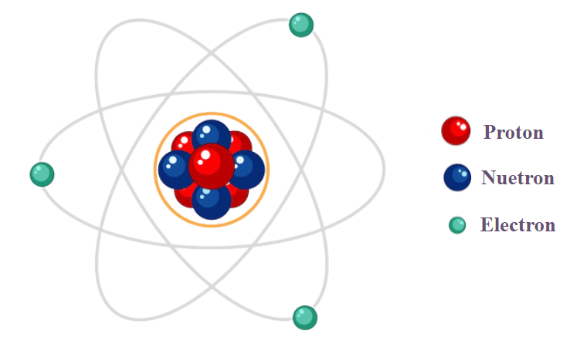
Structure of the Atom

Slide 52
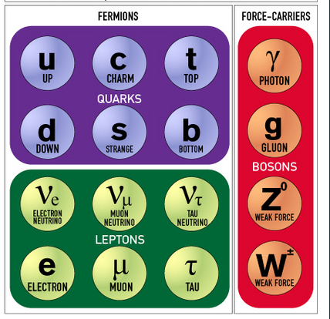
Elementary particles in the standard model

Slide 53
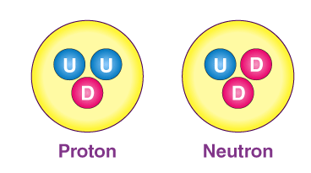

Slide 54
Pure substances
Elements
Hydrogen
Lithium
Oxygen
Carbon
Potassium
Compounds
Sodium Chloride (NaCl)
Water (H₂O)
Ammonia (NH₃)
Methane (CH₄)

Slide 55
Mixture
Mixtures consist of two or more different substances that are physically combined, not chemically bonded, and can vary in composition.

Slide 56
Mixtures
Homogenous
(mixture in which the components are evenly distributed throughout the mixture)
Examples:
Air
Saltwater
Alloy
Heterogeneous
mixture in which the components are not uniformly distributed, resulting in regions with different compositions and properties
Examples:
sand and water
concrete
blood
pizza

Slide 57
Atoms are the smallest units of matter that retain the chemical properties of an element.
Elements are pure substances that consist entirely of one type of atom.

Slide 58
Elements:
Oxygen
Helium,
Lithium,
Beryllium
Potassium

Slide 59
A COMPOUND is a group of two or more different atoms that are chemically bonded together.
Eg. HCl, NaOH, H₂O

Slide 60
Molecules can consist of two or more atoms of the same element or different elements (e.g., O₂, H₂O).

Slide 61
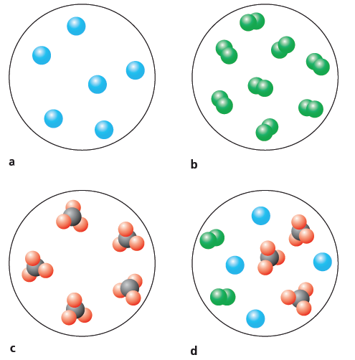
Reflecting on Matter
1. The diagrams below use different coloured spheres to represent the atoms of different elements. Use these terms to describe what each of the diagrams represent: pure substance, mixture, atom, molecule, element, compound.

Slide 62
2. Sketch a similar diagram to show a mixture consisting of a combination of
a. two elements
b. a compound and an element.

Slide 63
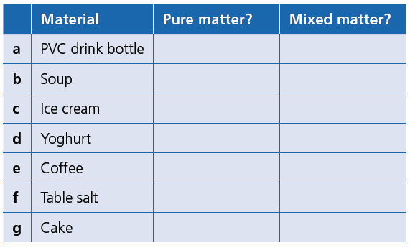
3. Predict whether the matter of the familiar materials
in the table is likely to be pure, and which are likely
to be mixtures.

Slide 64
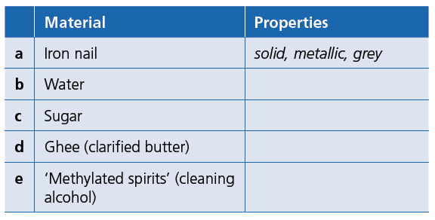
4. The matter in these common household materials
is usually nearly pure. List some properties you associate with these materials. The first example is completed for you.

Slide 65
LESSON 5
Properties of Matter

Slide 66
OBJECTIVE
By the end of the lesson, the student will be able to:
Use the boiling and melting points to explain how matter responds to temperature

Slide 67
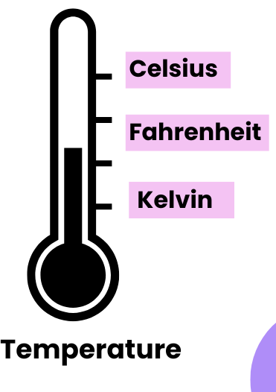
MATTER AND TEMPERATURE
Temperature is a measure of the average kinetic energy of the atoms or molecules within a substance or system
It indicates the degree of hotness or coldness
The SI unit is Kelvin (K)
Other units include Degree Celcius and Fahrenheit

Slide 68
Evidence of Matter
One clear evidence of matter is in the expansion and contraction in response to the surrounding temperature
Example:
the sizes of the ‘expansion joints’ in solid railway lines or bridges
the amount that overhead power cables sag during different seasons
the liquid inside a thermometer rises and falls in response to different temperatures.

Slide 69
If expansion and contraction in solids, liquids and gases are caused by changes in the:
■■ numbers of atoms objects contain, then hot objects
(which are larger) will have more particles, and therefore more mass
■■ sizes of the particles objects contain, then hot
objects (which are larger) will have larger particles, and
therefore more mass
■■ spaces between the particles objects contain, then
hot objects (which are larger) have the same number of
particles as cold objects and, therefore, the same mass.

Slide 70
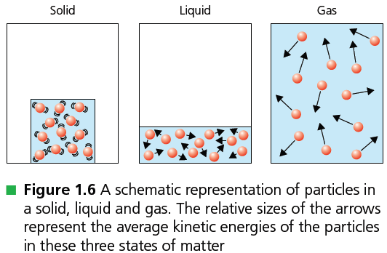

Slide 71
BOILING POINT
Boiling point refers to the specific temperature at which a liquid transitions into a gas, a process called vaporization
Boiling point of water = 100ºC

Slide 72
MELTING POINT
Melting point refers to the specific temperature at which a substance transitions from a solid to a liquid state
Melting point of ice = 0ºC

Slide 73
MELTING POINT
Boiling point refers to the specific temperature at which a substance transitions from a solid to a liquid state
Melting point of ice = 0ºC

Slide 74
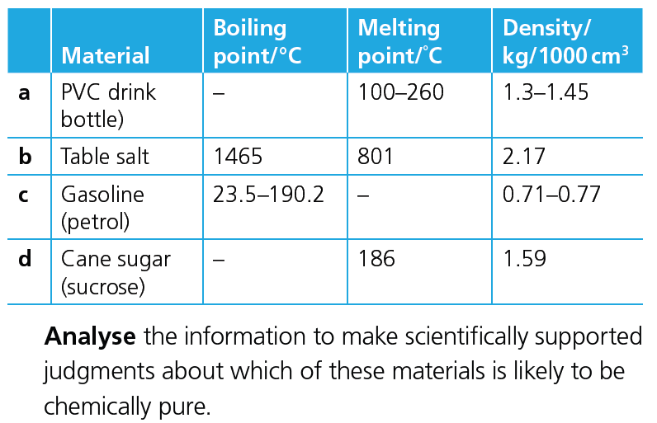
The table below shows some physical properties of
familiar, everyday substances.

Slide 75
Use these clues to help you solve such a question
Pure substances have single (sharp) melting/boiling points and a fixed density (at a stated temperature).
Mixtures show ranges (because different components change phase at different temps) and range of densities
Some pure substances decompose instead of boiling; that’s fine. Look for a single melting (or decomposition) point instead

Slide 76
Now go back and analyze the substances which are pure and the ones which are likely to be a mixture

Slide 77
LESSON 7
PHYSICAL AND CHEMICAL CHANGE

Slide 78
OBJECTIVES
By the end of the lesson, students will be able to
Differentiate between physical and chemical changes.
Identify signs of chemical changes.

Slide 79
Identify if the given processes are considered as a physical change or a chemical change
Burning of Wood
Dissolving Sugar in Water
Sublimation of Dry Ice
Rusting of Iron
Digesting Food
Melting of ice

Slide 80
Differentiating between Physical and Chemical Changes

Slide 81
often involve a change in the state of matter
Most physical changes are reversible
Physical Change
No Change in Chemical Properties
No New Substance Formed

Slide 82
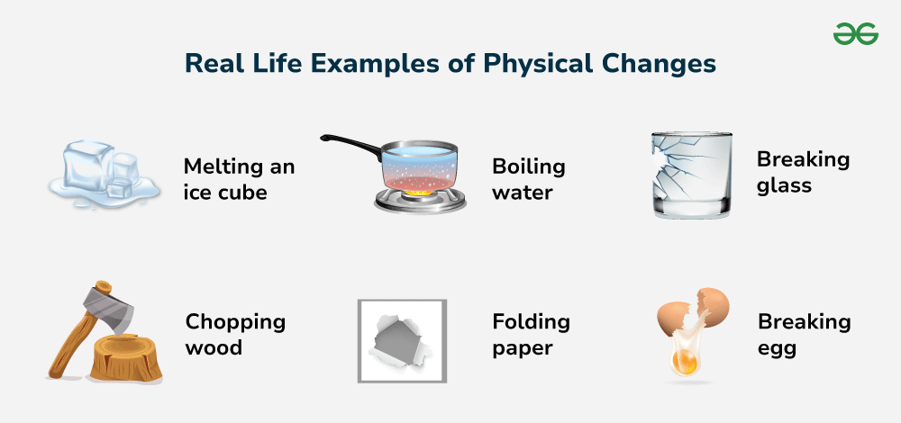

Slide 83
often produces visible signs such as the formation of a precipitate or the release of a a gas
Usually irreversible under normal conditions
Chemical Change
Some chemical changes release energy in the form of light or heat
New Substance Formed

Slide 84
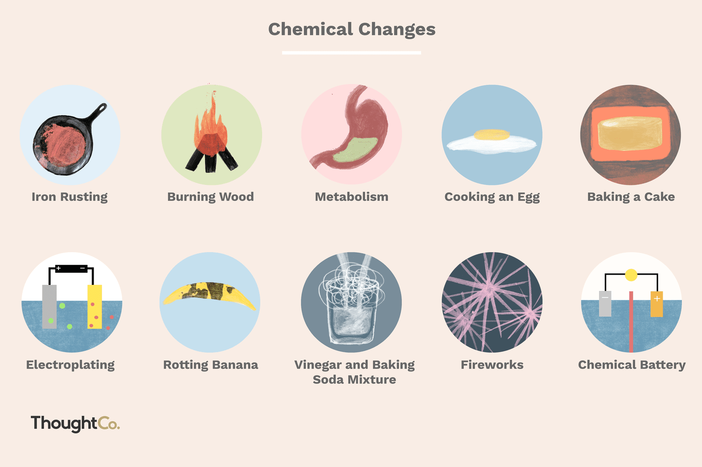

Slide 85
LESSON 8
LAB ACTIVITIES

Slide 86
LAB ACTIVITIES TO BE DONE
Experiment to determine the density of Regular objects
Experiment to determine the density of Irregular objects
How matter adds up
How matter mixes
Physical and chemical changes

Slide 87
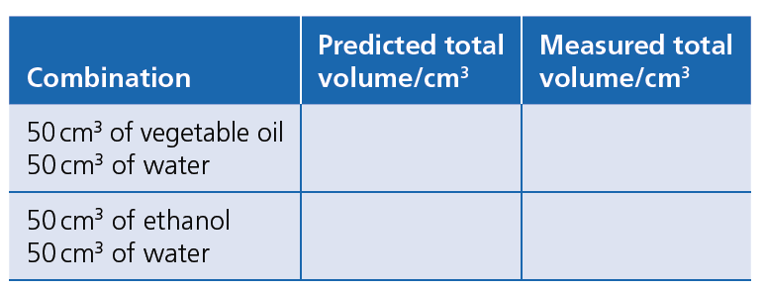
HOW MATTER MIXES

Slide 88
REASON FOR A LESS TOTAL VOLUME
Water is made of very small molecules.
Ethanol is made of bigger molecules.
When you pour them together, the small water molecules fit into the spaces between ethanol molecules
Water and ethanol are attracted to each other. This attraction pulls them closer together.
So the total space they take up becomes smaller.
This is called CONTRACTION OF VOLUME

Slide 89
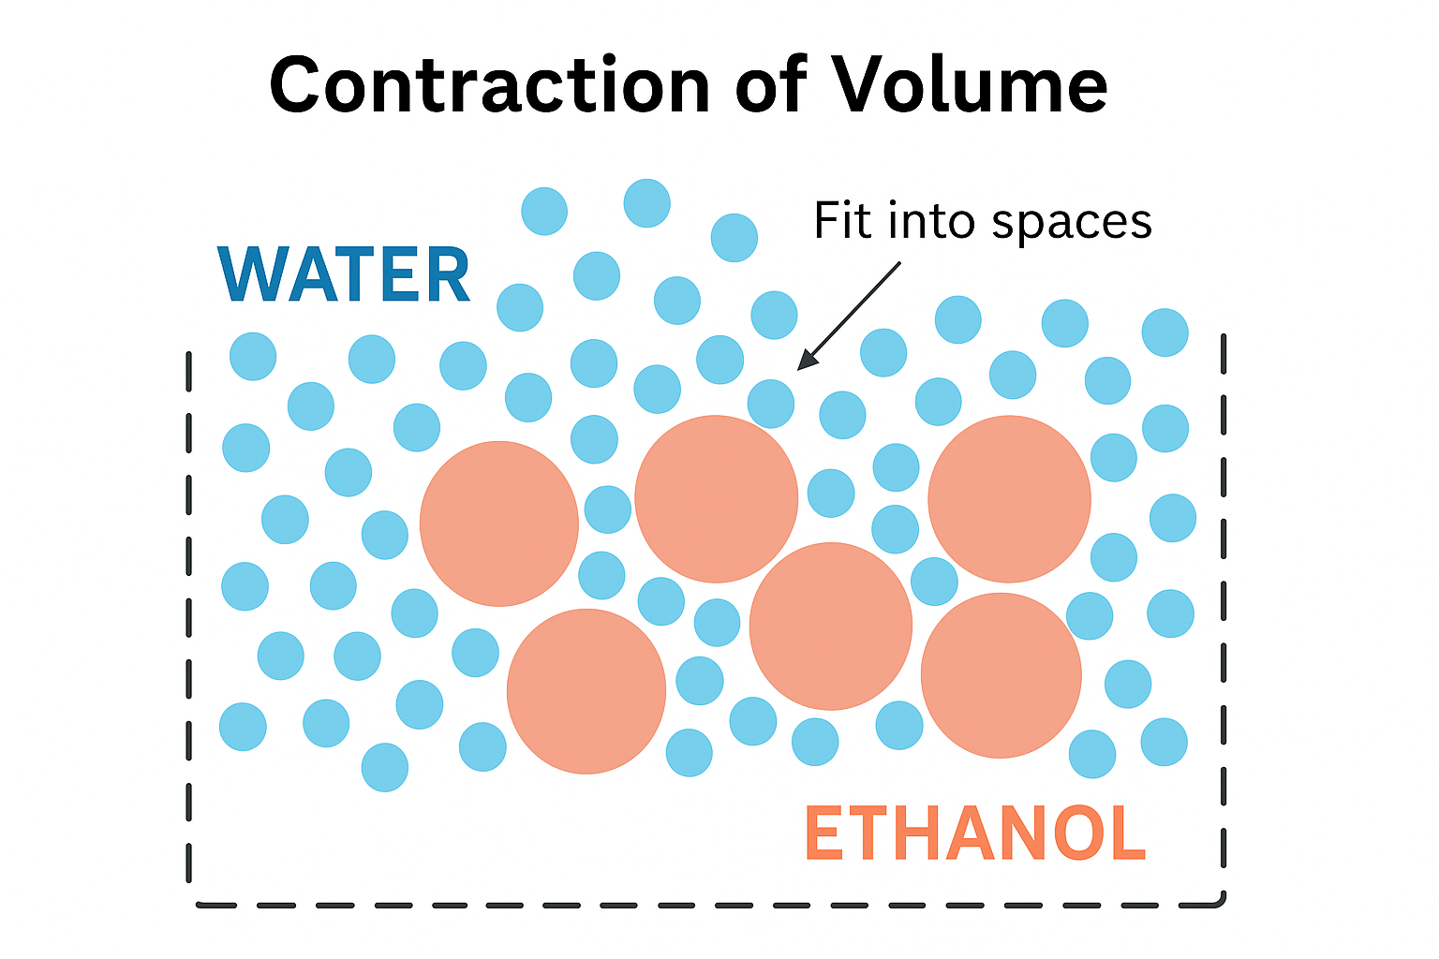

Slide 90
HOW MATTER ADDS UP
Aim: To observe how matter adds up
Materials and equipment
●■ electronic balance
●■ 100 cm³ measuring cylinders
●■ 100 cm³ beaker
●■ stirring rod
●■ water
●■ crystallized sugar or salt
●■ spatula (for moving dry ingredients)

Slide 91
Method
Predict the total mass of the substances when they are combined as shown in the table.
Tare the balance with the empty measuring cylinder on it. The next reading will only record the mass of the substance you are adding.
Measure the mass of 10 cm³ of solid sugar or salt.
Measure the mass of 60 cm³ of water.
Now combine the two materials in the beaker, and stir until all the solid has dissolved.
Complete the table.

Slide 92
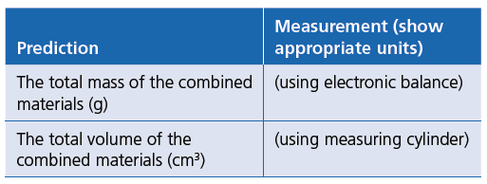

Slide 93
Analysing results
1. Suggest what happened to the sugar/salt.
2. Suggest how you might test whether the solid
substance is still in the container.
3. How do you explain your observations?
4. Sketch a model of your ideas in your notebook,
labelling how the particles of the mixed materials
might look.
5. What have the two activities suggested about the
nature of matter?

